Slide 1
Multi-Paradigmatic
Model-Based Testing
Wolfgang Grieskamp
Microsoft Research

Slide 2
Agenda
I. Model-Based Testing at Microsoft
II. Lessons Learned
III. A Multi-Paradigmatic Approach & Tool

Slide 3
Agenda
I. Model-Based Testing at Microsoft
II. Lessons Learned
III. A Multi-Paradigmatic Approach & Tool

Slide 4
Model-Based Testing at Microsoft
Applied since around 1999
Mailing list > 700 members (~10 % of MS testers)
A number of internal tools around
Microsoft Research tools:
  AsmL-T (2002)
  Spec Explorer 1 (2004)
  Spec Explorer 2 (in development)
➔ A success story, but MBT is not yet mainstream

Slide 5
How current MS tools work
Based on EFSM or ASM
  A set of parameterized actions
  A set of parameterized guarded update rules associated with actions
  Update rules fire in states where they are enabled
    Try all parameter combinations as defined by the user
  State transitions are labeled with associated actions
EFSM vs ASM (Spec Explorer): state space can grow dynamically

Slide 6
A Glance of Spec Explorer
[Campbell, Grieskamp, Nachmanson, Schulte, Tillmann, Veanes 2005]
Actions and update rules are defined as parameterized methods of an AsmL or Spec# model program
Actions are partitioned into controlled and observed ones
  Controlled = Input, Observed = Output
Alternating refinement provides the conformance notion
  SUT must simulate all control steps of Model
  Model must simulate all observation steps of SUT
Quick demo

Slide 7
Agenda
I. Model-Based Testing at Microsoft
II. Lessons Learned
III. A Multi-Paradigmatic Approach & Tool

Slide 8
Lessons Learned
Adoption Problems
  Authoring
  Executable Specification vs Programming Languages
  Scaling up to Model-Based Development
  Education and Documentation
Technological Problems
  State Explosion
  Test Selection
  Test Management

Slide 9
Lessons Learned
Adoption Problems
Technological Problems

Slide 10
Authoring
“Where is my IntelliSense?”
  Context-sensitive editing, incremental compilation, refactoring, etc. ubiquitous today
  Environments that support this probably more relevant than the actual languages
If you provide your own modeling notation, you better support decent authoring
But: Building decent authoring support for a language is probably by an order of magnitude more complex than writing its compiler

Slide 11
Executable Specification Languages
“Why do I have to learn this new language?”
  High-level language constructs hard to digest for many testers
  Mainstream programming languages catch up
    Let the language guys market this
Don’t mix up evangelizing MBT and your idea of language design
But: some stakeholders like those high-level languages, in particular outside of test organizations; therefore it is best to be agnostic regarding choice of languages.

Slide 12
Scaling up to Model-Based Development
“Isn’t this very low-level?”
“Where is the test plan?”
  Scenario-oriented (=interaction-based) modeling is ubiquitous in the process
Need to support scenarios, best using standard notations (UML)
But: Scenarios need to be combined (composed) with state-based models.

Slide 13
Education and Documentation
“I do not have time to learn this!”
“Where is the textbook for this?”
  People in the industry have not enough time to educate themselves
  Practical education material for MBT is poor
➔ Need better coverage at universities, text books, and individual tool documentation
But: chicken-and-egg problem: mainstream in university education requires proof of feasibility in industry.

Slide 14
Lessons Learned
Adoption Problems
TechnologicalProblems

Slide 15
State Explosion
“Cool! That stuff generates a large number of tests on the click of a button! ☺ … ☹”
  Test suite execution time is a significant productivity factor
  On-the-fly only works in particular test applications
➔ Need better techniques to reduce the state space
Partly solved by test purposes, but more is required (apply POR, state symmetries, etc. from MC)

Slide 16
Test Selection
“I want to have these tests from my model”
  Typical request: find the shortest path to a given state; from then on, apply link coverage.
Give users more fine-grained control over test selection, in particular, composition of test selection strategies
Partly solved by test purposes, provided exploration strategies and test selection can be controlled with test purposes

Slide 17
Test Management
“How does this integrate with my test management tool X?”
  Test generation only part of the testing problem
  A diversity of test management tools and processes around
Cannot prescribe test management from an MBT tool, but must be able to plug-in a variety of such frameworks

Slide 18
Agenda
I. Model-Based Testing at Microsoft
II. Lessons Learned
III. A Multi-Paradigmatic Approach & Tool

Slide 19
Multi-Paradigmatic?
par·a·digm (plural par·a·digms) noun
typical example: a typical example of something
model that forms basis of something: an example that serves as a pattern or model for something, especially one that forms the basis of a methodology or theory
relationship of ideas to one another: in the philosophy of science, a generally accepted model of how ideas relate to one another, forming a conceptual framework within which scientific research is carried out

Slide 20
Principles
Do not stick to a single paradigm
  State-based and scenario-based modeling
  Textual and diagrammatic notations
  Programming languages and specification languages
Support combination of paradigms
  Model composition
Fully integrate into a modern development environment
  IntelliSense, refactoring, and so on

Slide 21
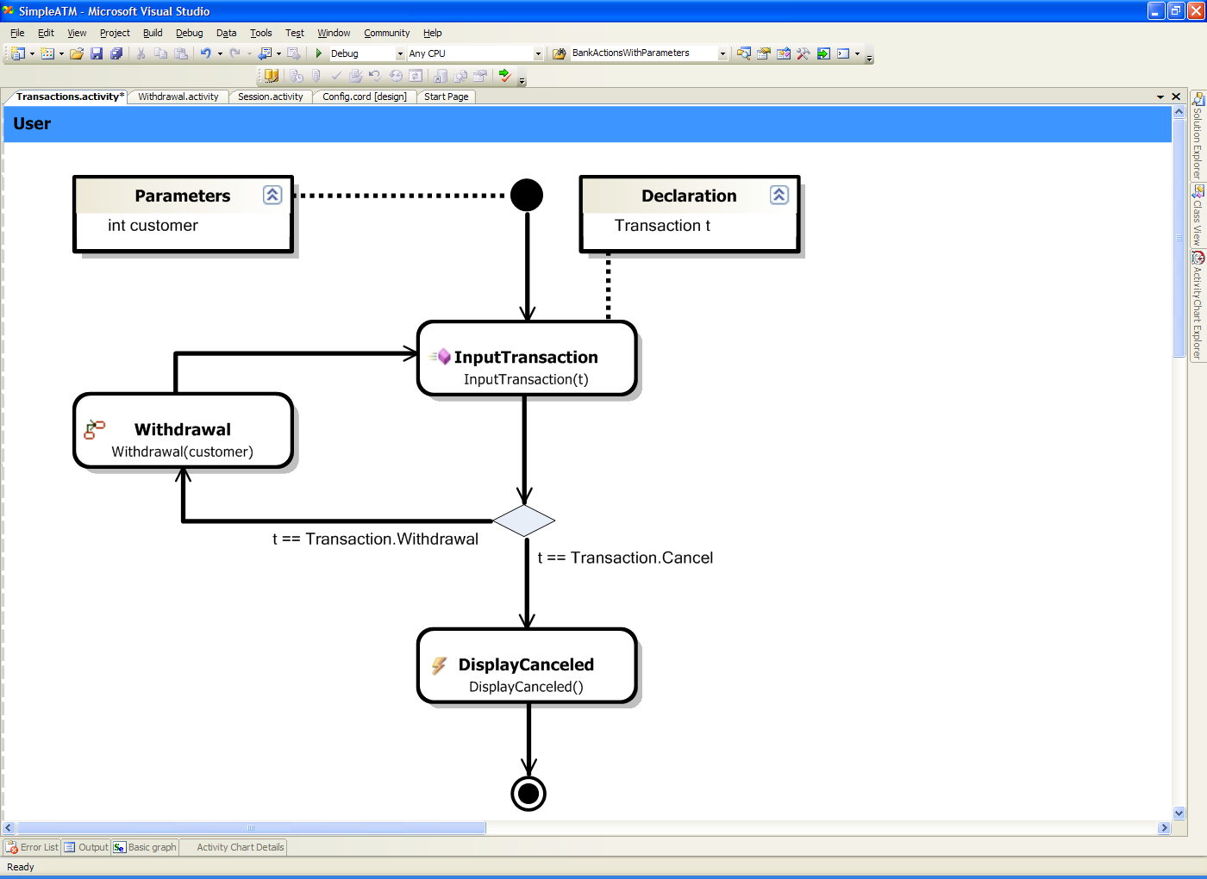
Quick Glance
Model with Charts
Model
Explore
Traverse
Test

Slide 22
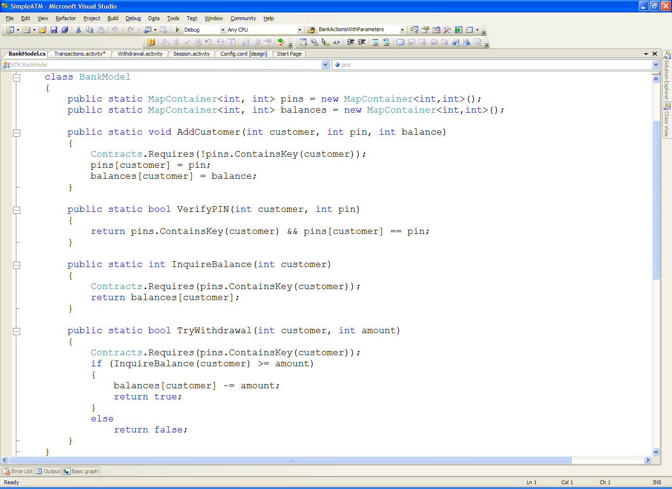
Quick Glance
Model with Programs
Model
Explore
Traverse
Test

Slide 23
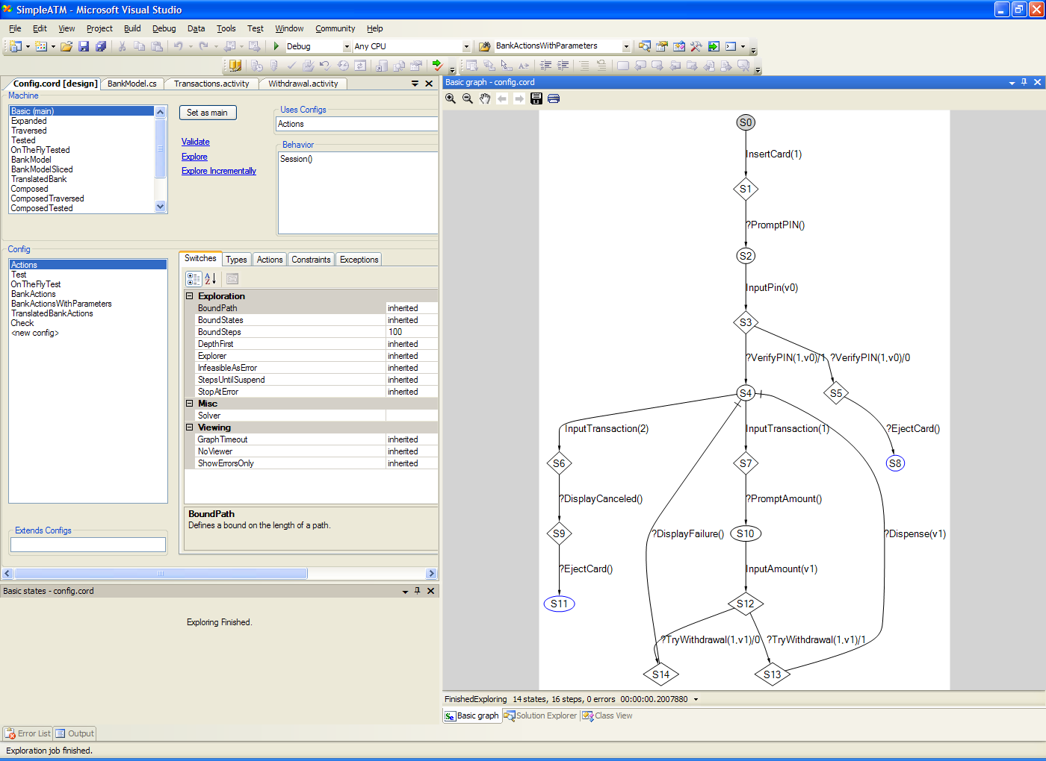
Quick Glance
Explore Individually or in Composition
Model
Explore
Traverse
Test

Slide 24
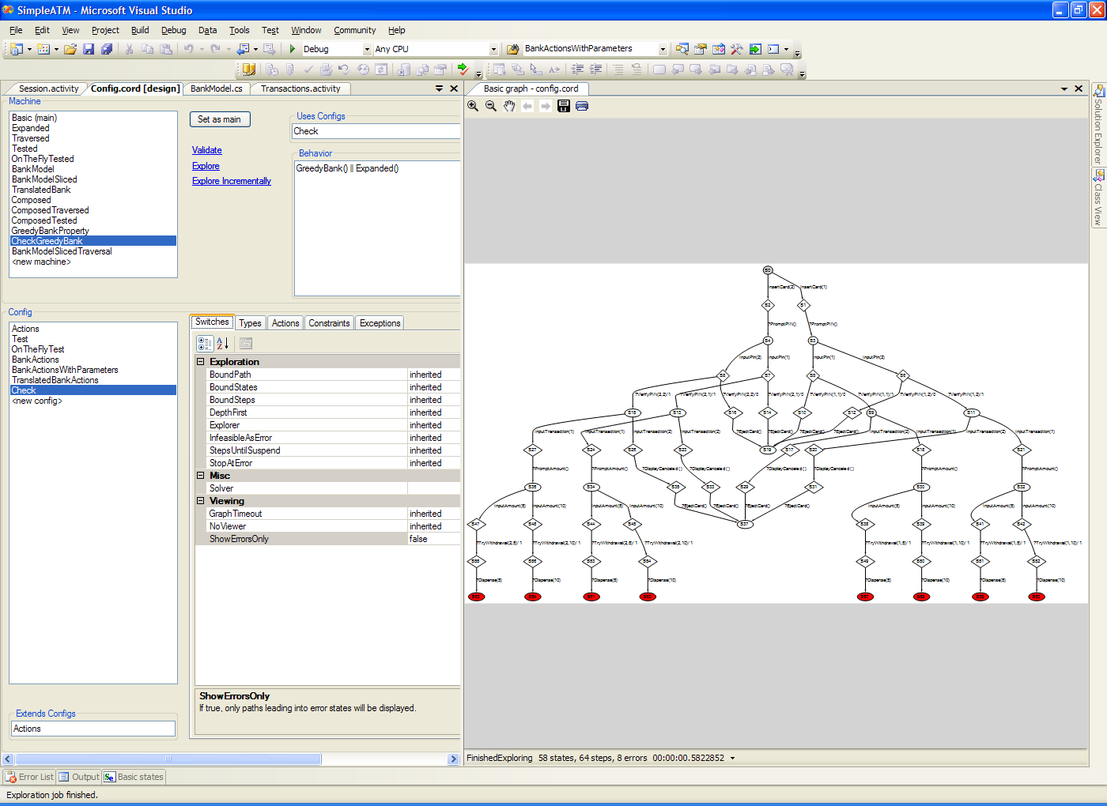
Quick Glance
Explore for Model-Checking
Model
Explore
Traverse
Test

Slide 25
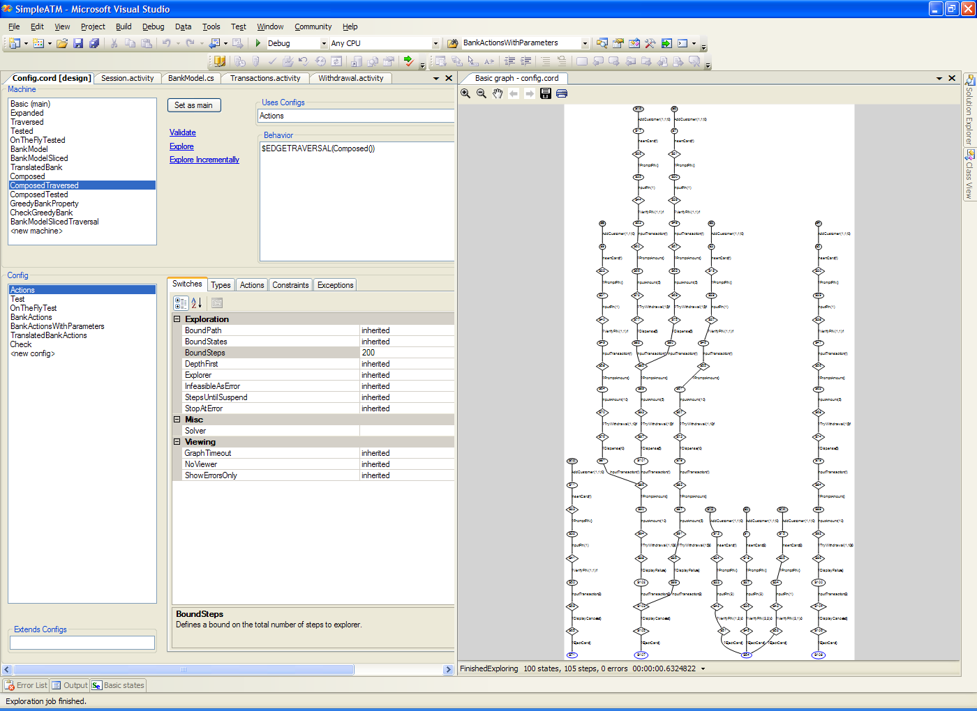
Quick Glance
Traverse for Test-Selection
Model
Explore
Traverse
Test

Slide 26
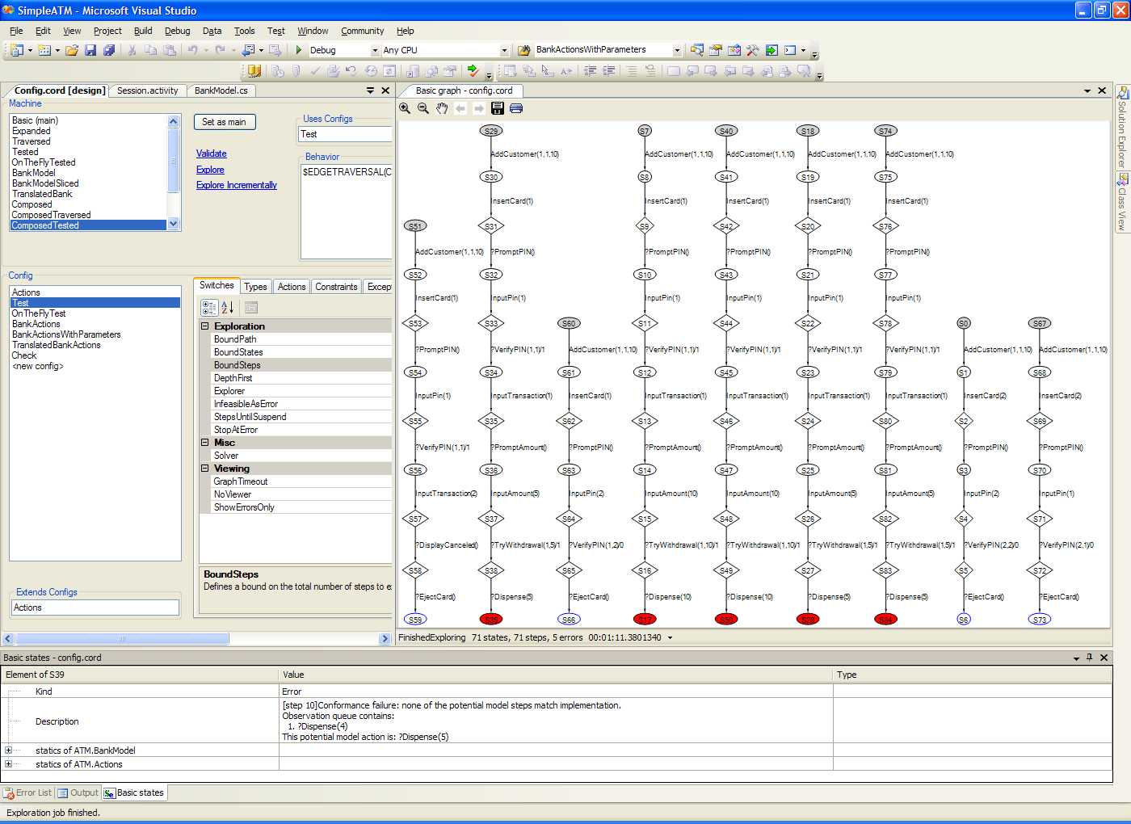
Quick Glance
Test Execution
Model
Explore
Traverse
Test

Slide 27
Demo

Slide 28
Foundations: Action Machines
[Grieskamp, Kicillof, Tillmann 2005/2006]
A combination of LTS and automata
Given:
   a set of terms with variables to represent values and action labels
   a set of environments mapping locations to terms
    Special location  containing the action label
     forms a complete lattice with meet and join
Action machine M = (C,A,I,T):
  C a set of control points
  A  C a set of accepting control points
  I      C initialization relation: e  (e’,c)  I
  T    C    C stepping relation: (e,c)  (e’,c’)  T
    Remark: the action label is contained in the special location 

Slide 29
Given Action Machines
Examples:
Guarded-update machine (encapsulates model program)
  Defined by a set of guarded-update rules
  Steps for each rule in each environment where the guard is true
  Step updates the environment
  Two control points: accepting and non-accepting
    Determined by a predicate over the environment
Single-step machine (building block for scenarios):
  Defined by an action term
  Two control points: before-step and after-step
    Before-step: enables transition into after-step labeled with action term
    After-step: nothing enabled
  Completely parametric over environment

Slide 30
Composed Action Machines
Examples:
Synchronized Parallel Machine
  Control points are product of control points of composed machines
  Steps if both machines step into an environment which has a non-empty join: (e,(c1,c2))  (e1’  e2’,(c1’,c2’)) if
    (e,c1)  (e1’,c1’)
    (e,c2)  (e2’,c2’)
    e1’  e2’ ≠
Sequential machine
  Control points are disjoint union of control points of composed machines
  Each step of the first machine leading into an accepting state is duplicated to lead also into an initial state of the second machine (simplified description)
  Justifies the need of the initialization relation: a machine can be initialized in the environment reached by another machine

Slide 31
Composed Action Machines (cont.)
Interleaving parallel composition
Repetition
Alternating refinement (interface automata)
Action translation
Declaration
Constraints
Hiding
Traversals
…

Slide 32
Implementation: XRT
[Grieskamp, Tillmann, Schulte 2005]
Virtual execution framework for .NET intermediate code
Implements mixed concrete/symbolic state space exploration
Action machines a thin layer on top of XRT

Slide 33
Agenda
I. Model-Based Testing at Microsoft
II. Lessons Learned
III. A Multi-Paradigmatic Approach & Tool

Slide 34
Conclusions
MBT successful but not mainstream
Application at MS suggests that tools need to be more powerful and simpler at the same time
  Let users model in mainstream languages (making modeling simpler) and different paradigms (adapting to roles in the process)
  Use model-composition as the cornerstone to provide additional power
Multi-paradigmatic MBT is a premier case study for model-based development in general.
Current plans at MSR:
  Ship the new Spec Explorer tool to internal customers
  Possibly ship as emerging technology externally
  Puhsh integration and/or spin-off for mainstream Visual Studio

Slide 35
The End
Checkout
http://research.microsoft.com/projects/specexplorer
for the current Spec Explorer tool and updates regarding the new tool
Checkout my website for papers
Thanks!

